Slide 1
HOME BASED CARE FOR PLWHA
Catherine Omasaja

Slide 2
MODULE OBJECTIVES
Define the concept of Home Based Care
Outline the philosophy and objectives of HBC
The Comprehensive Care Concept
Components of Home Based Care
Discuss the advantages and disadvantages of HBC
Constraints in HBC

Slide 3
HOME-BASED CARE FOR PLWHA
Introduction
A diagnosis of HIV infection or AIDS is a crisis for the infected person, family and friends
The PLWHA and family experience many losses over a very short period of time and this causes psychological distress
Examples of losses:
  Health, strength and physical beauty
  Ability to function in the family and community
The losses cause much grief, uncertainty, and unhappiness

Slide 4
Definition of Home-based Care
This is care given to patients with incurable diseases, starting from the time the diagnosis is made. The care is given at home but the caregivers at home communicate frequently with health facility workers for referral purposes when necessary.

Slide 5
Objectives of home-based care
1.To increase duration of life sometimes
2.To enhance quality of life
3.To facilitate a comfortable death with peace and dignity
4.To build the traditions, strength and values of a community in the care for each others needs

Slide 6
Philosophy of home-based care
Each person is of value, made in the image of God so he/she deserves respect, understanding and acceptance regardless of their illness
Each person has a right to information in order to make independent choices
Each person has physical, social, emotional and spiritual needs that need to be addressed when providing care

Slide 7
Cont. philosophy
Each person has a right to privacy and confidentiality
All persons that are important to the patient should be so to the care provider and be accorded care and attention as the patient

Slide 8

THE COMPREHENSIVE CARE CONCEPT
SPIRITUAL
SOCIAL
THE PERSON
EMOTIONAL
PHYSICAL

Slide 9
A person’s needs
To feel loved and valued
To have physical care and comfort
To be able to trust
To have honest communication
To have peace
of mind
To have hopes and goals
To be given respect and choice
To express his personality
To have dignity

Slide 10
The person who is ill relates to:
Spouse caregiver
Siblings, parents
Extended family
Other PLWHA’s
Colleagues peers
Community health worker
Children
Close friends church
Hospital doctors, nurses, team
Nurse at work

Slide 11
The comprehensive care team managing the patient
Doctors
Nurses
Spouse/partner
Physiotherapist
Other family and friends
Community services
Occupational therapist
Nutritionist
Counsellor
Spiritual Care givers

Slide 12
Components of HBC
1. Physical care
Medical and nursing – treatment of illnesses and symptoms; lab and pharmacy support
Physiotherapy – strengthening muscles and bone after illness and weight loss
Nutritional advice- provides nutrients needed for tissue growth, helps body fight opportunistic infections, helps maintain body weight, improves the effectiveness of drug treatments,
improves quality of life
Occupational therapy – to re-teach activities of
daily living; teach new skills for income generation

Slide 13
Components of HBC cont…
2. Psychological/emotional care
Given by the whole team – attitudes, how you greet patients, skills, knowledge, motivation and compassion
Counselling
Volunteers
Community health workers – home support

Slide 14
Components of HBC cont…
3. Social support
Community support – NGO’s, church
Private sector, individuals, organization
Examples include post test clubs for positive clients, clubs for adolescents and youth
Day care for children/adults where they can play games, share information etc

Slide 15
Components of HBC cont…
4. Spiritual Care
Care which relates to the spirit or soul of a person and facilitates its expression
Spiritual means that within a person that relates to, or reaches out to, God, to the Creator, or to ‘something or someone greater’
It also relates to values such as love, beauty, joy, honesty, integrity, absolute standards of right and wrong, forgiveness

Slide 16
Inter-agency team work
Hosp
Networking
Referrals
Church
VCT
NGO
Clinic
CBO

Slide 17
Advantages of home-based care
To the PLWHAs
Allows them to receive care in a familiar, supportive and environment
Allows them to continue participating in family matters
Maintains a sense of belonging to social groups
Reduced chances of opportunistic infections
It is economical to the patient and his family
Less stress to the patient and his family

Slide 18
Advantages of home-based care cont…
To the family
Holds family together
Helps family accept PLWHA’s condition
Can reduce medical costs
Makes it easier for family members who provide care to the PLWHA to attend to other responsibilities

Slide 19
Advantages of home-based care cont…
To the community
Promotes awareness about prevention of HIV/AIDS
Helps the community to understand the disease and counteract myths and misconceptions
Encourages sustainability of the care services
Can help the community maintain cohesiveness

Slide 20
Advantages of home-based care cont…
To the Health system
Helps ease demand on the health system
Extends responsibility to family and community
Does not require the creation of extra services where resources are already inadequate
Decongests hospital beds

Slide 21
Constraints to home-based care
Stigma- leads to the patient not seeking help when necessary
Inadequate resources
Lack of community participation
Socio-economic factors such as poverty
Poor infrastructure

Slide 22
Constraints to home-based care
Stigma- leads to the patient not seeking help when necessary
Inadequate resources
Lack of community participation
Socio-economic factors such as poverty
Poor infrastructure

Slide 23
SOCIAL BEHAVIOR CHANGE COMMUNICATION (SBCC)

Slide 24
Introduction
Definition of SBCC
Social Behavior change communication (BCC) is an
interactive process with communities to develop tailored messages and approaches using a variety of communication channels;
1. To develop positive behaviors.
2. Promote and sustain individual, community and societal behavior change.
3. Maintain appropriate behaviors.

Slide 25
Introduction (Cont’d)
In the context of the AIDS epidemic, BCC is an essential part
of a comprehensive program that includes both services (medical, social, psychological and spiritual) and commodities (e.g., condoms, needles and syringes).
Before individuals and communities can reduce their level
of risk or change their behaviors, they must first;
Understand basic facts about HIV and AIDS,
Adopt key attitudes,
Learn a set of skills and be given access to appropriate products and services.

Slide 26
Introduction (Cont’d)
They must also perceive their environment as supporting behavior change and the maintenance of safe behaviors, as well as supportive of seeking appropriate treatment for prevention, care and support.
In most parts of the world, HIV is primarily a sexually transmitted infection (STI).
Development of a supportive environment requires national and community-wide discussion of relationships, sex and sexuality, risk, risk settings, risk behaviors and cultural practices that may increase the likelihood of HIV transmission.
A supportive environment is also one that deals with stigma, fear and discrimination, as well as with policy and law, at the national and community levels.

Slide 27
Introduction (Cont’d)
The AIDS epidemic forces societies to confront cultural ideals and practices that can contribute to HIV transmission.
Effective BCC is vital to setting the tone for compassionate and responsible interventions.
It can also produce insight into the broader socioeconomic impacts of the epidemic and mobilize the political, social and economic responses needed to mount an effective program.

Slide 28
Role of BCC/SBCC
BCC is an integral component of a comprehensive HIV & AIDS prevention, care and support program.
It has a number of different but interrelated roles. Effective BCC can:
1. Increase knowledge. BCC can ensure that people are given the basic facts about HIV and AIDS in a language or visual medium (or any other medium that they can understand and relate to).

Slide 29
Role of BCC/SBCC (Cont’d)
2. Stimulate community dialogue. BCC can encourage community and national discussions on the basic facts of HIV&AIDS and the underlying factors that contribute to the epidemic, such as risk behaviors and risk settings, environments and cultural practices related to sex and sexuality, and marginalized practices (such as drug use) that create these conditions.
It can also stimulate discussion of healthcare- seeking behaviors for prevention, care and support.

Slide 30
Role of BCC/SBCC (Cont’d)
3. Promote essential attitude change: BCC can lead to appropriate attitudinal changes about, for example, perceived personal risk of HIV infection, belief in the right to and responsibility for safe practices and health supporting services, compassionate and nonjudgmental provision of services, greater openmindedness concerning gender roles and increasing the basic rights of those vulnerable to and affected by HIV and AIDS.
4. Advocate BCC can lead policymakers and opinion leaders toward effective approaches to the epidemic.

Slide 31
Role of BCC/SBCC (Cont’d)
5. Reduce stigma and discrimination: Communication about HIV prevention and AIDS mitigation should address stigma and discrimination and attempt to influence social responses to them.
6. Create a demand for information and services: BCC can spur individuals and communities to demand information on HIV & AIDS and appropriate services.
It can contribute to development of a sense of confidence in making and acting on decisions.
7. Improve skills and sense of self-efficacy: BCC
programs can focus on teaching or reinforcing new
skills and behaviors, such as condom use, negotiating safer sex and safe injecting practices

Slide 32
Role of BCC/SBCC (Cont’d)
8. Promote services for prevention, care and support: BCC can promote services for STIs, intravenous drug users (IDUs), orphans and vulnerable children (OVCs); voluntary counseling and testing (VCT) for mother-to-child transmission (MTCT); support groups for PLHA; clinical care for opportunistic infections; and social and economic support. BCC is also an integral component of these services.

Slide 33
KEY ROLE OF STIGMA IN BCC
Failure to address stigma jeopardizes BCC programs in critical ways:
Prevention: BCC programs that fail to address stigma allow some people to ignore the messages of HIV prevention.
Stigma can cause people to perceive individuals with or at risk for HIV as the other (“them”), reinforcing their feeling that HIV “couldn’t happen to me.”
Failure to address stigma can also deter individuals from seeking out VCT and proper medical care, including MTCT prevention services.
Stigma is also sometimes attached to carrying condoms.
Stigma can work against prevention programs.

Slide 34
KEY ROLE OF STIGMA IN BCC (Cont’d)
Quality of care. Stigma can perpetuate harmful practices, such as discrimination against or poor treatment of PLHA, IDUs, MSM, or SWs.
A BCC campaign to increase demand at a health facility would be hurt if poor quality of care were encountered there by PLHA.
Policy. Programs that fail to address stigma help perpetuate discriminatory laws and practices and, in some cases, result in failure to enforce laws against them.
Such programs also miss an opportunity to influence policy direction.

Slide 35
The Process of Behaviour Change
SBCC Process: A process of promoting and sustaining healthy changes in the behavior of individuals and communities through participatory development of appropriately tailored health messages and approaches that are conveyed through a variety of communication channels

Slide 36
The Process of Behaviour Change
Stage 1- Stages of behavior change continuum
Unaware
Aware
Concerned
Knowledgeable
Motivated to change
Practicing trial behavior change
Practicing sustained behavior change

Slide 37
The Process of Behaviour Change (Cont’d)
Stage 2- Enabling factors
Providing effective communication.
Creating an enabling environment- policies, community values, human rights.
Providing user- friendly, accessible services and commodities.

Slide 38
The Process of Behaviour Change (Cont’d)
Exercise
Time Duration: 5 mins Work in pairs
List some ways of creating a supportive environment for appropriate health behavior

Slide 39
The Process of Behaviour Change (Cont’d) - Exercise (ANSWER)
Example ways to create a supportive environment for appropriate health behavior
Direct political action to create policies and regulations, such as tobacco control legislation
Providing financial incentives or disincentives, for example, sponsoring alcohol-free events
Advocacy designed to gain political commitment, social acceptance, or policy change, for example, supporting community groups to advocate banning junk food advertising to children

Slide 40
The Process of Behaviour Change (Cont’d) - Exercise (ANSWER)
Providing education and empowerment, and enabling communities and individuals to take control of their health and environment, for ex., teaching people in a disadvantaged community the skills to research local health needs
Strengthening links between health and environmental strategies, including creating partnerships, for ex., working with sustainable living practices and implementing walking or cycling programs

Slide 41
The Process of Behaviour Change (Cont’d) - Exercise (ANSWER)
Ensuring equitable access to supportive environments for health by mediating between conflicting interests in society, for ex., promoting sexual health and well-being for people with disabilities being inclusive in plans involving community
Being inclusive in plans involving community members and staff, for ex., consulting community members to identify the best approaches to health and well-being
Creating supportive settings for people using health services, for example, making waiting rooms feel welcoming for people with friendly staff, seating, play areas for children, access to water, and promotion of the role of the arts in health

Slide 42
The Process of Behaviour Change (Cont’d) - Exercise (ANSWER)
Promoting health in the workplace, for ex., implementing stress management programs for staff, helping staff quit smoking, or providing healthy snack options in vending machines.
Notes:
Source: Department of Health and Human Services 2018.

Slide 43
The Process of Behaviour Change (Cont’d)
Stage 3- Channels
Mass media
Community networks and traditional Media.
Interpersonal communication.
Group communication.
Conclusion
When changing behavior, the individual, community,
or institution goes through a series of steps – sometimes moving forward, sometimes moving backward and sometimes skipping steps.

Slide 44
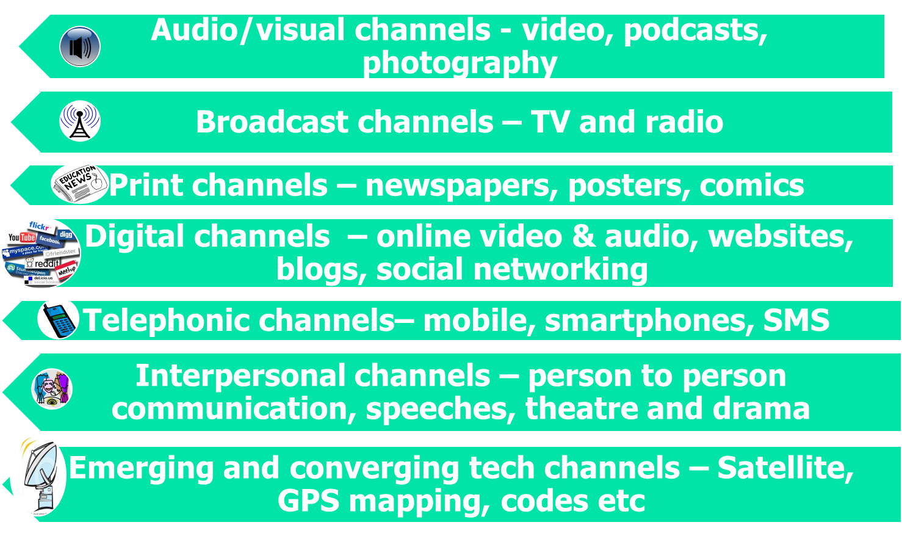
CHANNELS OF DISSEMINATION
Notes:
There is a wide diversity of old and new communication technologies and media platforms that can be used in implementing change communication. These include:
Broadcast routes: television and radio
Audio visual routes: video, podcasts, photography and more
Print routes: newspapers, IEC materials, posters, graphic publications and more
Telephonic routes: mobile telephones – 3G and further, SMS, landline
Digital routes: online platforms - email-based, web-based, social networking platforms, online databases, audio-visual online and more
Satellite routes: satellite television and other content
Innovations: personal handheld devices PDA and other innovations around delivery of technology, wind-up radios, one child – one computer and many others
Convergent routes: the combination of one or more of these options, such as SMS and community radio for listener input in a regular talk show
Emerging routes: the innovations are constantly emerging, particularly in the area of the multi-platform mobile+ routes, such as the scanning of two dimensional barcodes (quick response or QR). Again, it will depend on your context and the needs of your audience.

Slide 45
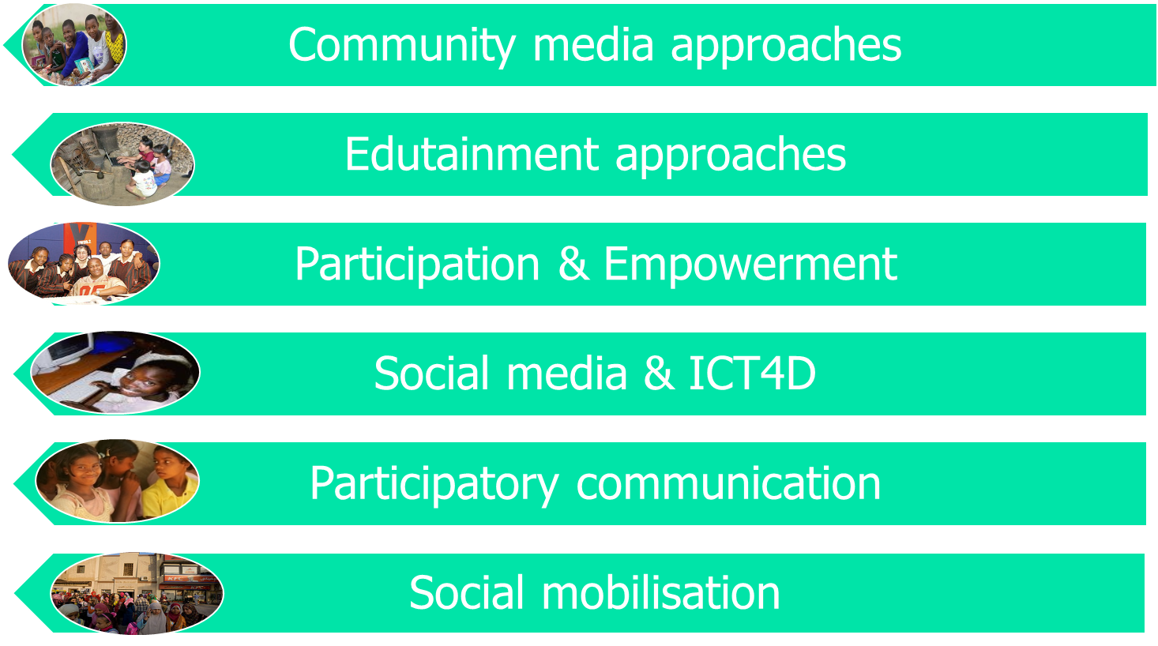
APPROACHES to SBCC
Notes:
These varied methodologies are often presented as approaches
Emphasising the choice of communication channel: community media approaches Emphasising the use of a particular type of format: edutainment such as soap opera
Emphasising a particular type of engagement: peer to peer education for example ...... These options (and many more) are neutral as far as being useful/not useful, relevant/not relevant (although there is huge debate about effective options ) ...... BUT the deciding factor is that they have to be appropriate to the context - it is the context that needs to lead the choice of what approach to take and what methodologies to use ......
And the context needs to be clearly understood (research) so that choices are based on evidence. If you still don’t know, then talk to people around you who can advise you or give you’re their view points but make sure to ask them of examples of similar choices they made in the past, why and what were the results.

Slide 46
What Can SBCC Do? – Goals?
Increase knowledge
Stimulate community dialogue
Promote essential changes in attitudes
Reduce stigma and discrimination
Create a demand for information and services
Advocate
Promote services for prevention, care, and support
Improve community members’ skills and sense of self-efficacy

Slide 47
SBCC Goals
Behavior change communication goals need to be developed in the context of overall program goals and specific behavior change goals.
The following highlights the place of BCC goals within an overall program.
Program goal: Reduce HIV prevalence among young people in urban settings in country X.
Behavior change goals:
Increase condom use.
Increase appropriate STI care-seeking behavior.
Delay sexual debut.
Reduce number of partners.

Slide 48
SBCC Goals (Cont’d)
Increase perception of risk or change attitudes toward use of condoms.
Increase demand for services.
Create demand for information on HIV and AIDS.
Create demand for appropriate STI services.
Interest policymakers in investing in youth-friendly VCT services (services must be in place)
Promote acceptance among communities of youth sexuality and the value of reproductive health services for youth (services must be in place)

Slide 49
SBCC Goals (Conclusion)
BCC goals are related to specific issues identified when assessing the situation, knowledge, attitudes and skills that may need to be changed to work toward behavior change and program goals.
Using RDTs
Health care workers in the health facility (and community health workers in some countries) have been trained to use the RDT correctly and safely
Only a few drops of blood are needed to find out if the viruses are in the blood
It takes only 15 minutes for the test result to be ready

Slide 50
GUIDING PRINCIPLES FOR SBCC
1. BCC should be integrated with program goals from the start. BCC is an essential element of HIV prevention, care and support programs, providing critical linkages to other program components, including policy initiatives.
2. Formative BCC assessments must be conducted to improve understanding of the needs of target populations, as well as of the barriers to and supports for behavior change that their members face (along with other populations, such as stakeholders, service providers and community).
3. The target population should participate in all phases of BCC development and in much of implementation.
4. Stakeholders need to be involved from the design stage.

Slide 51
GUIDING PRINCIPLES FOR SBCC (Cont’d)
5. Having a variety of linked communication channels is more effective than relying on one specific one.
6. Pre-testing is essential for developing effective BCC materials.
7. Planning for monitoring and evaluation should be part of the design of any BCC program.
8. BCC strategies should be positive and action oriented.
9. PLHA should be involved in BCC planning and implementation.

Slide 52
Steps in developing a BCC strategy
1. State program goals
Clearly identifying overall program goals is the first step in developing a BCC strategy.
Program goals are established after reviewing existing data, epidemiological information and in-depth program situation assessments.
2. Involve stakeholders
Key stakeholders need to be involved early on in every step of the process of developing HIV &AIDS programs and their BCC components.
Stakeholders include policymakers, opinion leaders, community leaders, religious leaders and members of target populations, including PLHA.

Slide 53
Steps in developing a BCC strategy (Cont’d)
Their active participation at appropriate stages of BCC strategy development is essential.
A stakeholders’ meeting should be held at the planning stage to obtain guidance and commitments to the process and to develop coordination mechanisms

Slide 54
Steps in developing a BCC strategy (Cont’d)
3. Identify target populations
To develop communication, it is important to identify the target populations as clearly as possible.
Target populations are defined as primary or secondary.
Primary populations are the main groups whose HIV & AIDS-related behavior the program is intended to influence.
Secondary populations are those groups that influence the ability of the primary population to adopt or maintain appropriate behaviors.
For ex., an HIV program may seek to increase condom use among sex workers and clients (primary populations). But to achieve this objective, it may be necessary to change the behavior or gain the support of brothel owners and police (secondary populations).

Slide 55
Steps in developing a BCC strategy (Cont’d)
Target populations include:
i. Individuals at high risk or vulnerability, such as sex workers, their clients, youth, migrant workers, IDUs, or uniformed services personnel
ii. People providing services, such as health workers, private practitioners, pharmacists, counselors and social service workers
iii. Policymakers, such as politicians
iv. Leaders and authorities, formal and informal, including law-enforcement, social and religious leaders
v. Local communities and families

Slide 56
Steps in developing a BCC strategy (Cont’d)
4. Segment target populations
Based on the formative BCC assessment, target populations can then be segmented.
For example, sex workers can be grouped more specifically according to work location (street, home, brothel), income level, ethnicity, or language.
5. Conduct formative BCC assessments
• The formative BCC assessment should collect information on:
Risk situations, showing in detail how decisions are made in different situations, including what influences the decisions and settings for risk
Why individuals and groups practice the behaviors they do, and why they might be motivated to change (or unable to change) to the desired behaviors

Slide 57
Steps in developing a BCC strategy (Cont’d)
Perceptions of risk and risk behaviors
Influences on behavior, such as barriers or benefits
Insights of opinion leaders
Patterns of service use and opinions about these services
Perceptions of stigma and discrimination
Future hopes, fears and goals
Media and entertainment habits
Health care-seeking behaviors
Positive deviants, or those most willing to model change
Media resources

Slide 58
Steps in developing a BCC strategy (Cont’d)
6. Define behavior change objectives
• Whether the target population is a particular group or the general public, it is important first to refer to the HIV & AIDS program behavior change objectives.
• Following are some common behavior change objectives:
1) Increased safer sexual practices (more frequent condom use, fewer partners)
2) Increased incidence of healthcare-seeking behavior for STIs, TB and VCT (for example, calls or visits to facilities)
3) Increased use of universal precautions to improve blood safety

Slide 59
Steps in developing a BCC strategy (Cont’d)
7. Design BCC strategy and Monitoring and Evaluation (M&E) Plan
• A BCC strategy is best designed in a participatory fashion, including members of target populations, organizations planning to work with them and stakeholders.
• A well-designed BCC strategy should include:
1) Clearly defined objectives
2) An overall concept or theme and key messages
3) Identification of channels of dissemination
4) Identification of partners for implementation (including
capacity-building plan)
5) A monitoring and evaluation plan

Slide 60
Steps in developing a BCC strategy (Cont’d)
8. Develop communication products
• Observable changes in behavior, as specified in the behavior change objectives, are a final program outcome. Such changes are generally preceded by intermediate changes e.g.,:
1) Knowledge change: e.g., an increase in knowledge among targeted youth of modes of transmission
2) Attitude change: e.g., an increase in perception of personal risk or a change in authorities’ attitudes toward promoting condoms to youth
3) Environmental change: e.g., a decrease in harassment of sex workers by police or an increase in acceptance of messages about condom use on television.

Slide 61
Steps in developing a BCC strategy (Cont’d)
An effective BCC strategy needs to be developed to guide achievement of intermediate and longer-term outcomes. Examples of BCC objectives are:
Increased demand for information about HIV and AIDS. (Youth will ask for information about HIV and AIDS.)
Increased knowledge about HIV and AIDS. (Youth will have correct knowledge of modes of transmission of HIV and AIDS.)

Slide 62
Steps in developing a BCC strategy (Cont’d)
9. Conduct pre-testing
Pre-testing is key to ensuring that themes, messages and activities reach the intended target populations.
It is important to pre-test at every stage with all audiences for whom the communication is intended, both primary and secondary.
Pre-testing should be done of themes, messages, prototype materials, training packages, support tools and BCC formative assessment instruments.

Slide 63
Steps in developing a BCC strategy (Cont’d)
10. Implement and monitor
In the implementation phase, all elements of the strategy go into operation.
An especially important element is management.
All partners, programmers and channels of the BCC strategy must be closely coordinated.
There must be links among critical program elements, such as supply and demand.
It is important that monitoring be carried out as planned.

Slide 64
Steps in developing a BCC strategy (Cont’d)
11. Evaluate
Evaluation refers to the assessment of a project’s implementation and its success in achieving predetermined objectives of behavior change.
BCC interventions should be evaluated against their stated objectives and in reference to a baseline that may be qualitative or quantitative (or both).
12. Elicit feedback and modify the program
As programs evolve, target populations acquire new knowledge and behaviors, and communication needs may change.
Day-to-day monitoring will provide information for making adjustments in short-term work planning

Slide 65
Challenges to BCC
1. BCC vs. IEC. In practice, IEC has often resulted in the production of discrete communication material’s. The use of the term BCC is part of an effort to establish communication as strategic and integrated into entire programs.
2. Integrating BCC into all programs. BCC is a component of all successful interventions and must be included in their original design. However, in reality this doesn’t always happen. It is essential to identify opportunities for improving the quality of communication components.
3. Limited training resources. Limited capacity and availability of trained, in-country resource people, including advertising agencies and media outlets, can hamper the effective implementation of BCC programs.

Slide 66
Challenges to BCC (Cont’d)
4. Political and physical environments.
In some countries, geography and population diversity can complicate the development of BCC programs.
This is especially the case where vast distances must be covered, or multiple languages and cultural traditions included, in a single country program.
5. Sustainability. To be effective, BCC strategies and components must evolve constantly to meet the changing needs of target populations.
This requires the continuous input of human and financial resources.

Slide 67
Challenges to BCC (Cont’d)
6. Expanding the response. To have a real impact on the epidemic, responses must be expanded in quality, scope of activities and geographic coverage. Expanding comprehensive BCC strategies is a continuing challenge
7. Budgets. The steps necessary to develop a comprehensive BCC strategy are often not adequately budgeted. For example, a budget will be prepared for the production of materials but not for the process necessary to develop the appropriate content.
8. Linkages and coordination. For BCC to be effective, their messages and information should be coordinated. Building and maintaining linkages and coordination is an ongoing challenge.

Slide 68
THE ROLE OF IEC IN HIV & AIDS PROGRAMMES
1. Sharing information - Ensuring that communities have information to understand the relationship between sexual behaviour and HIV and STI transmission, about seeking care, about protecting themselves and taking preventive measures.
2. Advocacy - Encouraging discussion of social, economic and organizational factors which are barriers to behaviour change and good health.
3. Promoting services and products - Advertising and promoting services such as counseling, STI treatment, condom provision, and promoting products such as condoms.

Slide 69
THE ROLE OF IEC IN HIV & AIDS PROGRAMMES(Cont’d)
4. Building public opinion - Changing public opinion, for ex., attitudes towards people with HIV and combating stigma and discrimination, and encouraging resource allocation for treatment of people with HIV & AIDS.
5. Shaping attitudes - Shaping the attitudes and behaviour of future generations through targeting schoolchildren and young people.

Slide 70
THANK YOU

